Slide 1


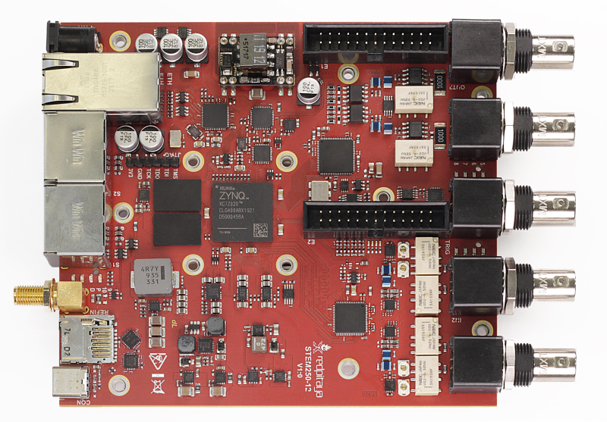
Backend (FastAPI) And Python
AWS S3
FAST API
Website
User
Red Pitaya Sensor
Frontend (React.js)
Local Storage

